Slide 1

By:- Abhi Yadav

Slide 2

SehaatSaathi: Your AI Health Assistant
Welcome to SehaatSaathi, your trusted AI health assistant. We're here to help you stay healthy, anytime, anywhere.
Sehaatsaathi is an AI-powered Virtual Health Assistant designed to provide users with personalized healthcare advice, symptom checking, emergency treatment suggestions, and doctor consultations. This project aims to empower individuals to make informed health decisions and access real-time support for managing their health. The app integrates advanced AI models to ensure accurate diagnosis and treatment recommendations while keeping healthcare accessible to everyone, especially in rural and underserved communities.

Slide 3
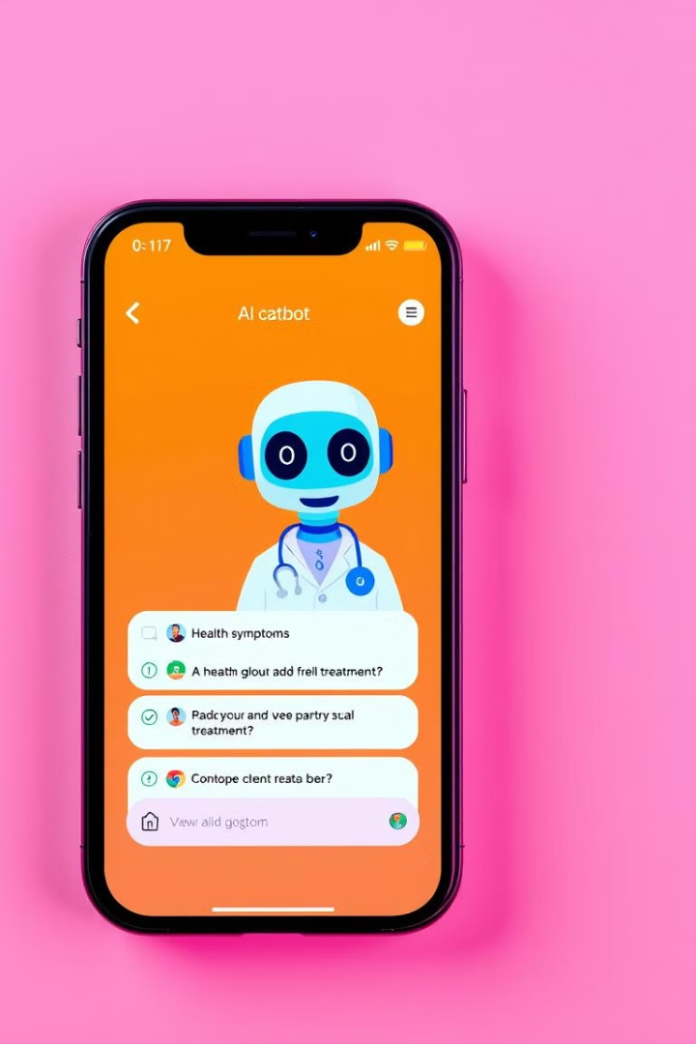
Core AI Healthcare Features
1
AI-Powered Virtual Doctor Chatbot
2
AI-Based Symptom Checker
Get personalized healthcare advice and symptom checking.
Identify potential health issues and receive guidance.
3
AI-Based Medicine Suggestion
4
Emergency Protocols & First-Aid Assistance
Receive general guidance on medication (not a substitute for medical advice).
Learn how to handle emergencies and receive immediate support.

Slide 4
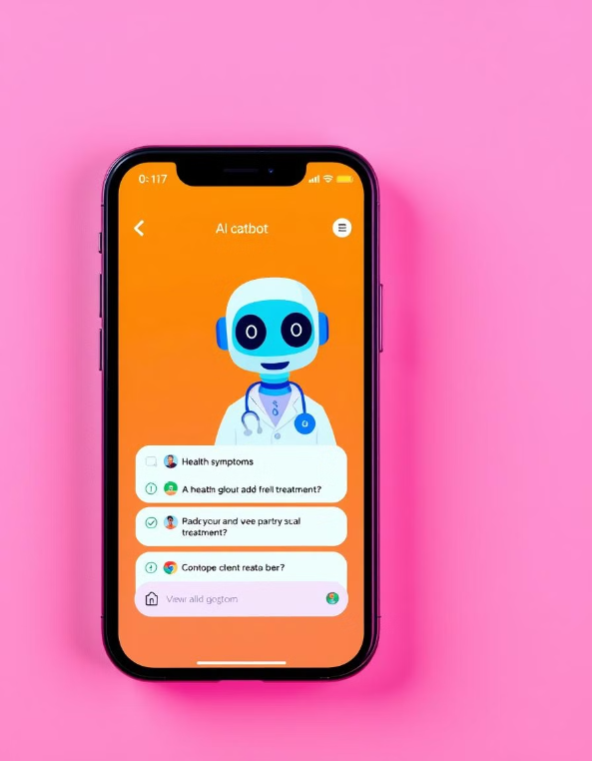
Follow-up Reminders & Symptom Monitoring
Doctor Consultation Integration

Slide 5
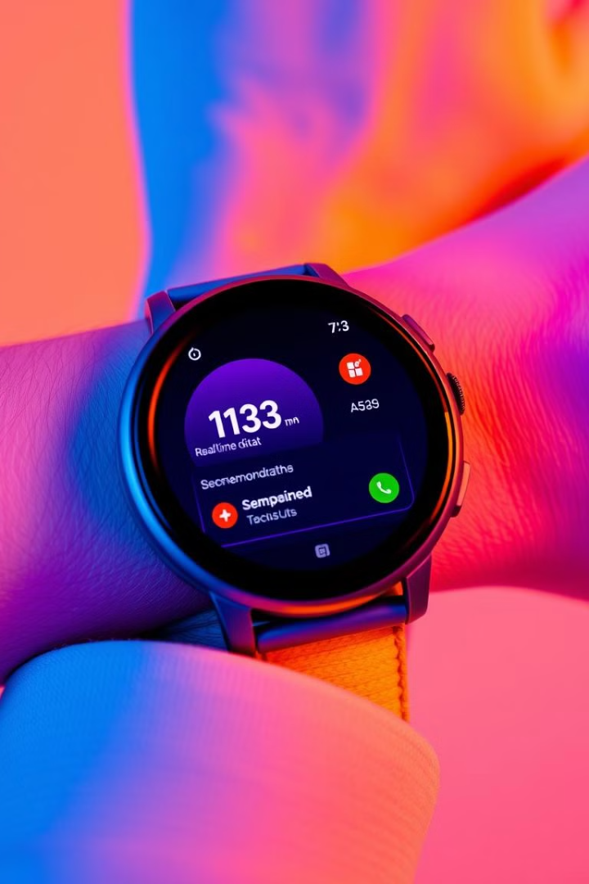




Advanced AI Features
Personalized Health Recommendations
Smart Wearable Integration
Receive tailored advice based on your health data.
Monitor your heart rate, blood pressure, and oxygen levels.
AI Image Processing
Mental Health Assistance
Analyze skin conditions and receive self-diagnosis support.
Access resources and support for mental well-being.

Slide 6
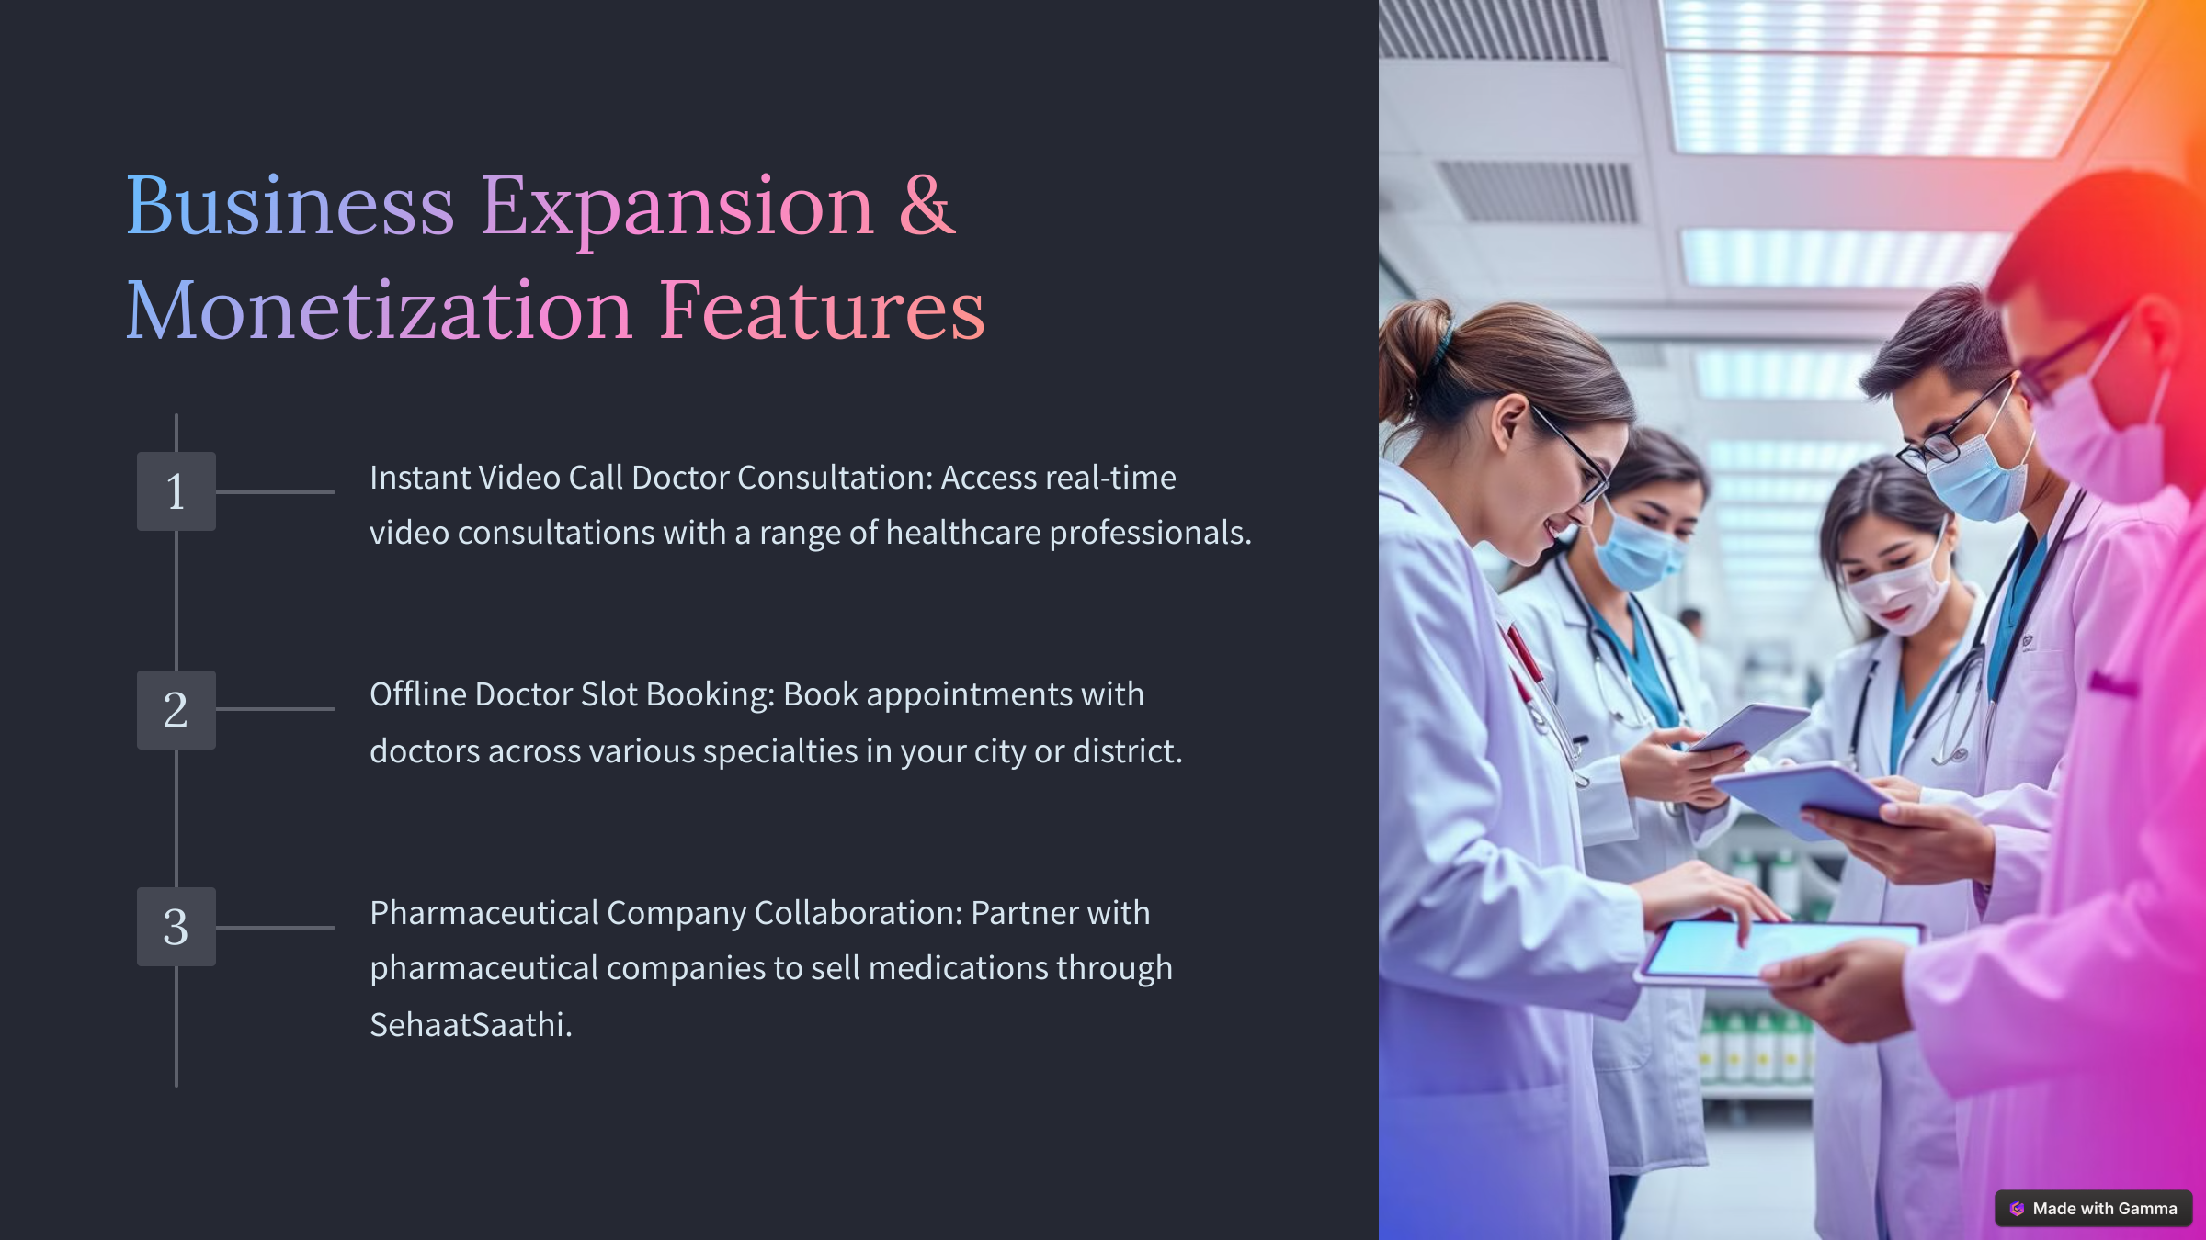

Slide 7
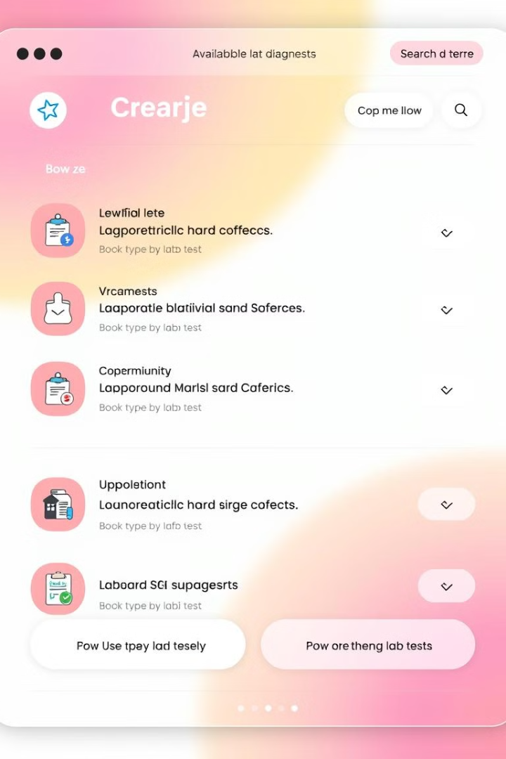
Additional Healthcare Services
Online Doctor Consultation
Medicine Ordering & Delivery
Consult with doctors remotely via text or video chat.
Order medications online and have them delivered to your doorstep.
Lab Test & Diagnostic Test Booking
Schedule lab tests and diagnostic procedures conveniently.

Slide 8




Future Expansion Features
1
AI-Powered Preventive Healthcare Plans
2
AI-Generated Personalized Exercise & Yoga Plans
3
Blockchain-Based Secure Health Data Storage
4
Health Insurance & Coverage Suggestion

Slide 9
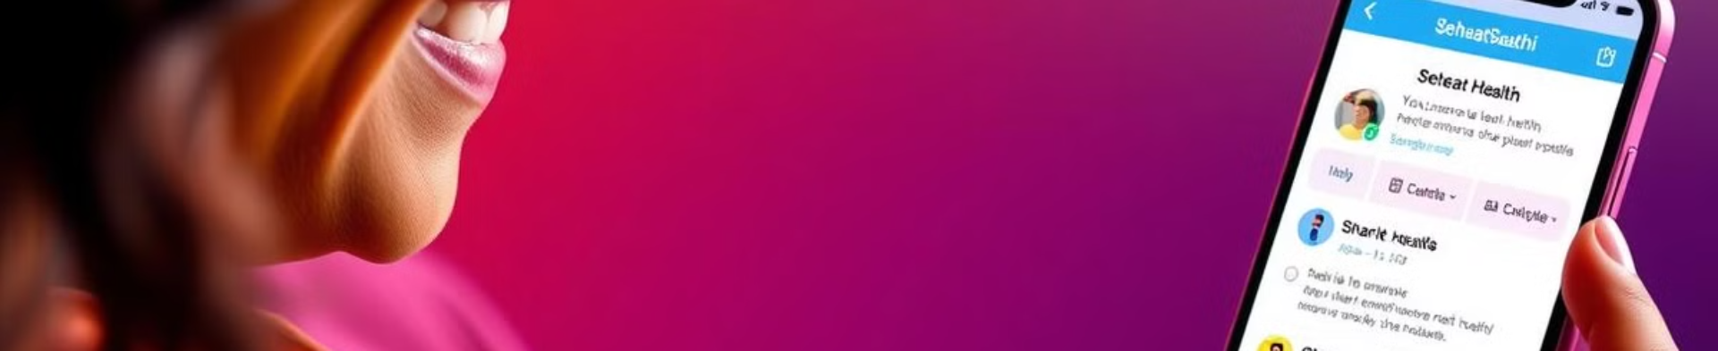
Empowering Individuals
SehaatSaathi is designed to empower individuals to make informed health decisions and access real-time support for managing their health.

Slide 10


Slide 11

Accessible Healthcare for All
SehaatSaathi aims to make healthcare accessible to everyone, especially in rural and underserved communities.

